Slide 1
APA Referencing(7th Edition)
Learning Support AIC 2023

Slide 2
Why Reference
Referencing is used to tell the reader where ideas from other sources have been used in an assignment.
Without references, the reader cannot judge the reliability of any facts you mentioned in your assignment.
To avoid plagiarism and high similarity rate.

Slide 3
Intext Citation
An in-text citation is needed whenever you have used information from another source. If you have paraphrased, summarised, or quoted another author, you need to provide an in-text citation.
In-text citation contains basic information about the source:
Author’s name
Publication year
Example: Asthma is the most common disease in Queensland (Smith, 2020).

Slide 4
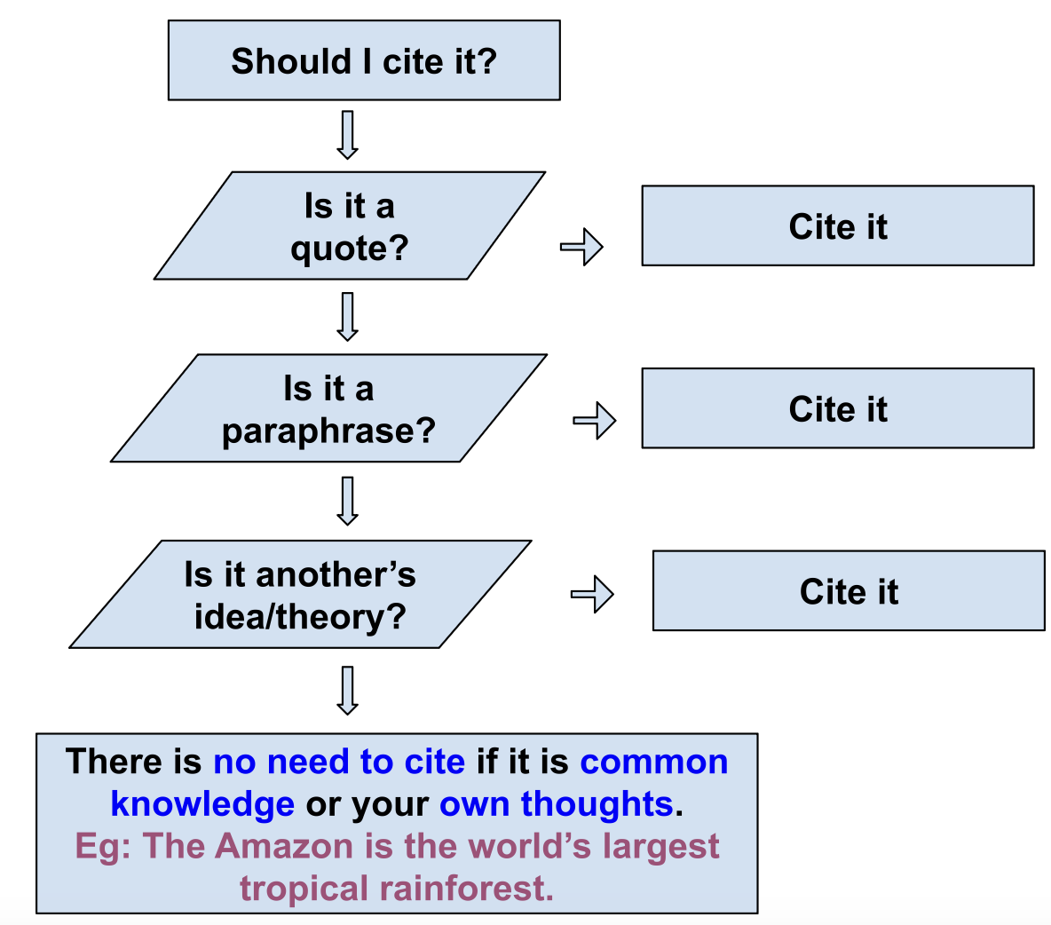
Citation Chart

Slide 5
Intext Citation
E.g.: Data confirm that the trend is rising (Watson, 2021).
E.g.: Watson (2021) wrote that most people tend to follow the path of least resistance.
E.g.: According to Watson (2021), dogs make unique eye contact with humans.

Slide 6
Intext Citations
Two Authors
Eg: Jones and Smith (2018) described the issue in more details.
E.g.: The authors stated all the data was accurate (Jones & Smith, 2020).
Three or more authors
E.g.: Martin et al. (2020) found that the majority of schools…….
Eg: The authors stated all the data was accurate (Martin et al., 2020).

Slide 7
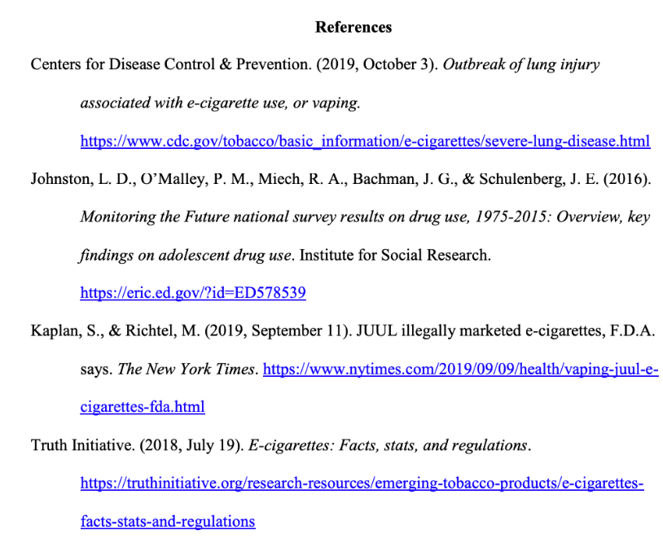
Reference List
Hanging indent 0.5”/1.27cm
“References”, Bold, Centred, New page
Double spaced
Alphabetically sorted

Slide 8
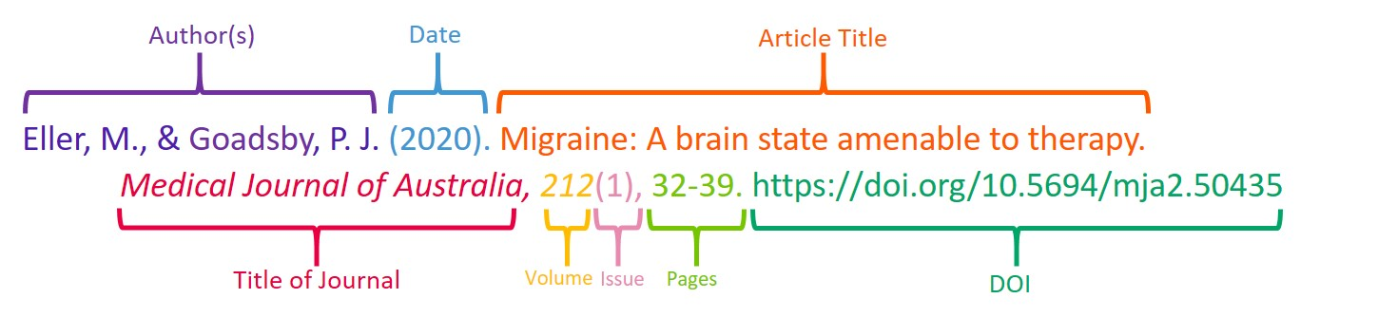
Referencing a Journal Article

Slide 9
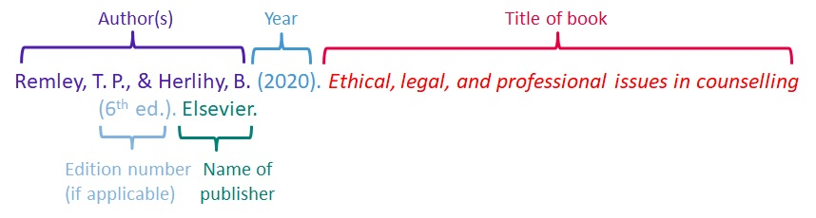
Referencing a Book

Slide 10
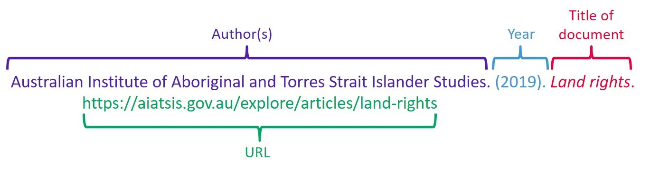
Referencing a Website

Slide 11
Guide to Referencing
1. APA Manual 7th Edition
2. https://apastyle.apa.org/
3. https://studentservices.op.ac.nz/learning-support/citingandreferencing/#a398
4. https://www.scribbr.com/

